Slide 1
Involving parents and carers in Maths
A workshop for parents/carers of children in EYFS to find out more about how children are taught and learn maths at Oakmeadow.

Slide 2
What is this meeting for?
To help you understand how we teach Mathematics in EYFS
To support you to work with your child at home
To share practical ideas and resources
For you to ask questions

Slide 3
Why is your involvement important?
The evidence about the benefits of parents and carers being involved in their children’s education in general is overwhelming.

Slide 4
Parental involvement in their children’s learning positively affects the child’s performance at school in both primary and secondary schools leading to;
higher academic achievement,
greater cognitive competence,
greater problem-solving skills,
greater school enjoyment,
better school attendance and
fewer behavioural problems at school

Slide 5
Although parental involvement has the greatest effect in the early years, its importance to children’s educational and literacy outcomes continues into the teenage and even adult years

Slide 6
The old Early Learning Goal

Slide 7
The EYFS Early Learning Goal
Number
Have a deep understanding of number to 10, including the composition of each number.
Subitise (recognise quantities without counting) up to 5.
Automatically recall (without reference to rhymes, counting or other aids) number bonds up to 5 (including subtraction facts) and some number bonds to 10, including double facts.

Slide 8
The EYFS Early Learning Goal
Numerical Patterns
Verbally count beyond 20, recognising the pattern of the counting system.
Compare quantities up to 10 in different contexts, recognising when one quantity is greater than, less than or the same as the other quantity.
Explore and represent patterns within numbers up to 10, including evens and odds, double facts, and how quantities can be distributed equally.

Slide 9
A welcome change
The focus is now on numbers to 10. This deep knowledge can then be applied to the number system.

Slide 10
Teaching for mastery
What does it mean to master something?
I know how to do it
It becomes automatic – I can do it without needing to think
I’m really good at it
I can show someone else how to do it

Slide 11
Features of teaching for mastery in the early years………..
Slower pace
Going deeper
Attention to mathematical concepts, relationships and structures.

Slide 12
The mastery approach to mathematics also embraces the Characteristics of Effective Learning that are key to learning in Early Years.

Slide 13
Vocabulary
Counting – 5 principles (stable order – the verbal sequence, 1:1 correspondence, cardinality, abstraction i.e. it doesn’t matter what you count, how you count stays the same and order irrelevance)
Subitising – perceptual (up to 3) and conceptual (sub groups in a larger set)
Cardinality – the last number tells us how many
Ordinality – the position of a number
Composition – parts it is made of
Comparison – describing sets, more than, fewer than (when counting things)
Stem sentences

Slide 14
Counting rules
We say one number name as we count one item.
We say the number names in the right order.
If we do this,
We know that the last number that we count, is the total number of objects.
With regular practice, we also learn that we can ‘move’ the objects but if we don’t add any or take any away, the same number will remain.

Slide 15
Subitising
Being able to say how many there are without counting. Learning without the abstract maths.
Perceptual subitising – to just know…

Slide 16
Conceptual subitising –
where we recognise small amounts and combine them.
Key skills to be able to partition and recombine numbers flexibly.
Supports understanding of all four operations and efficient calculation.

Slide 17
With lots of experience of subitising, children start to recognise parts of numbers, so for example, here they may say, ‘I know it’s 5 because I can see 3 and 2’. They start to calculate before they know that they are calculating – it’s the early stages of composition of number e.g. 1 and 4 makes 5.

Slide 18
Subitising in practice…
https://axis.ncetm.org.uk/mastering-number/videos-reception/
https://axis.ncetm.org.uk/mastering-number/videos-reception/

Slide 19
Once children are confident with subitising, we begin to structure numbers and develop an understanding of place value.

Slide 21
Representation and Structure

Slide 22
Progression
Objects
Pictures
Numbers and signs

Slide 24
Mastering Number
A carefully structured progression for teaching number.
Our own medium term plans to teach other skills – shape, space, measure etc.

Slide 25
Autumn term
Pupils will build on previous experiences of number from their home and nursery environments, and further develop their subitising and counting skills.
They will explore the composition of numbers within 5. They will begin to compare sets of objects and use the language of comparison.

Slide 26
Spring term
Pupils will continue to develop their subitising and counting skills and explore the composition of numbers within and beyond 5. They will begin to identify when two sets are equal or unequal and connect two equal groups to doubles. They will begin to connect quantities to numerals.

Slide 27
Summer term
Pupils will consolidate their counting skills, counting to larger numbers and developing a wider range of counting strategies. They will secure knowledge of number facts through varied practice.

Slide 28
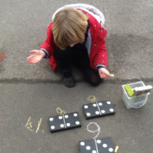
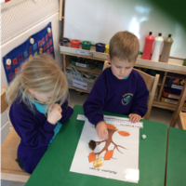
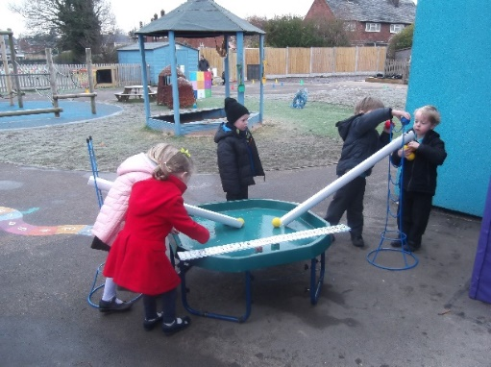
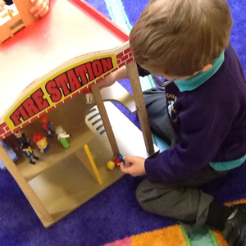
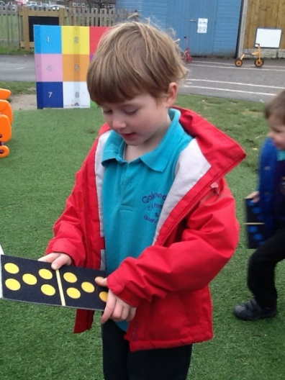
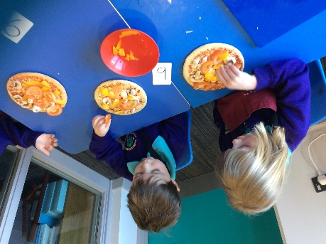
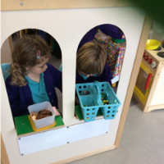
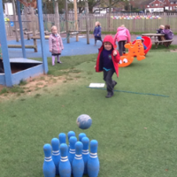
Solving problems during play

Slide 29
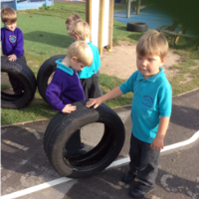
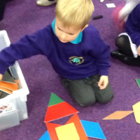
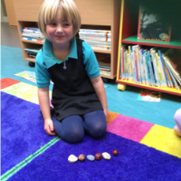
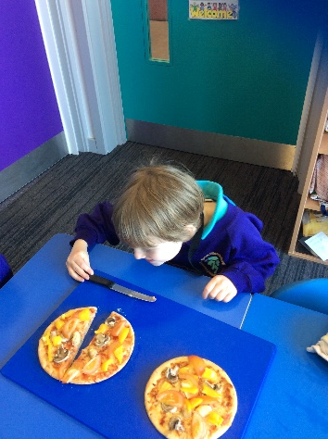
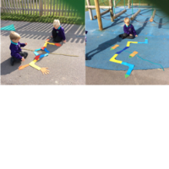
Shape and pattern

Slide 30
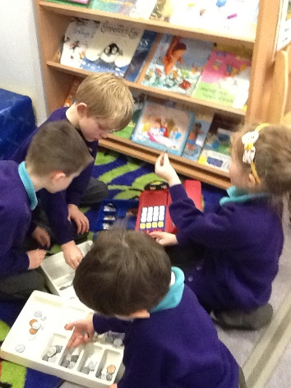
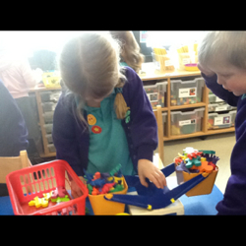
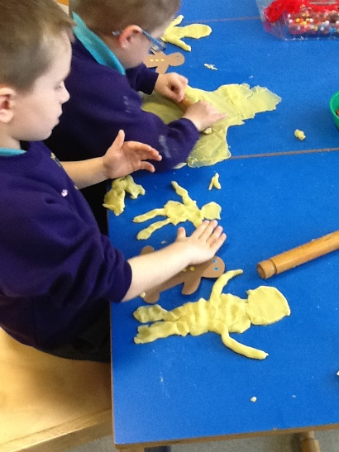
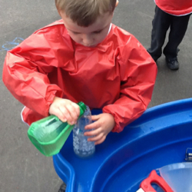
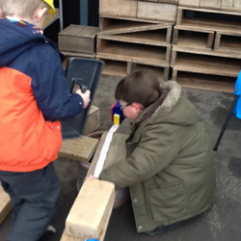
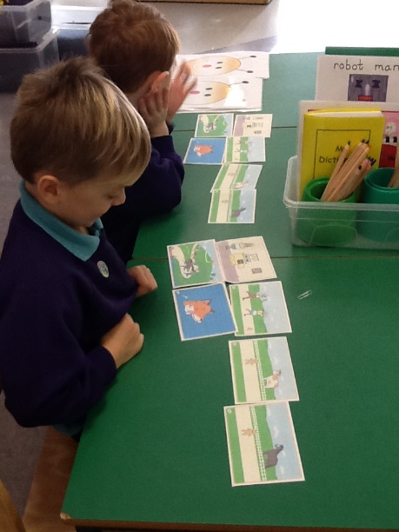
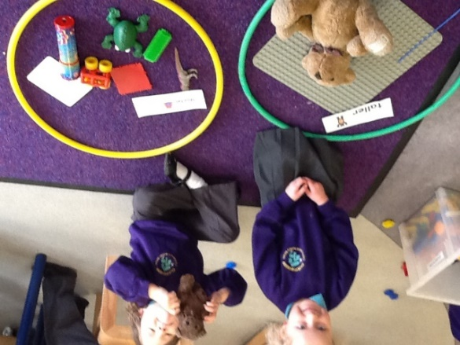
Measures

Slide 31
Progression into Year 1 – Autumn term
Number sense: numbers to 10
Counting, saying number names in order, cardinality to 10. Use the 5 principles of counting.
Counting objects to 10
Counting to zero
Subitising Representation of number
Read, write and say numbers
Ordering and comparing numbers
Knows the counting patterns from 1 to 100.
Knows that counting can go forwards or backwards in order.

Slide 32
Spring term
Place value and Calculation
Number bonds 0-10
Combing sets- addition (aggregation)
Making the amount bigger (argumentation)
Subtraction within 20 – removing from the set as takeaway.
Subtraction within 20– finding the difference as counting up.
Concept of equality
Concept of the effect of zero when adding and subtracting.
Developing mental strategies for addition and subtraction
Partitioning, recombining and writing the numbers accurately

Slide 33
Summer Term
Number sense and arithmetic:
Revisit and consolidate
Continuing to work on number structures
Promoting the number sense arithmetic
e.g 8 + 4 = 8 +2+2
Doubles and near doubles 7 + 8 e.g double the smaller number and add 1.
Missing number problems using bar model to expose the structure
Counting, reading and writing number patterns

Slide 34
Year 1
NCETM video
Videos – Year 1 | NCETM Axis

Slide 35
What you can do at home
Talk about maths
Count using the 5 principles
Subitise
Sing with numbers
Play and explore
Use numbers, shapes and measure in everyday situations
Practise number formation

Slide 36
Thank you for your support at home
Some resources to use
http://www.ictgames.com
Number Blocks
Numbots
Topmarks
Woodlands Resources
Maths skill builders
Mathletics

